Slide 1
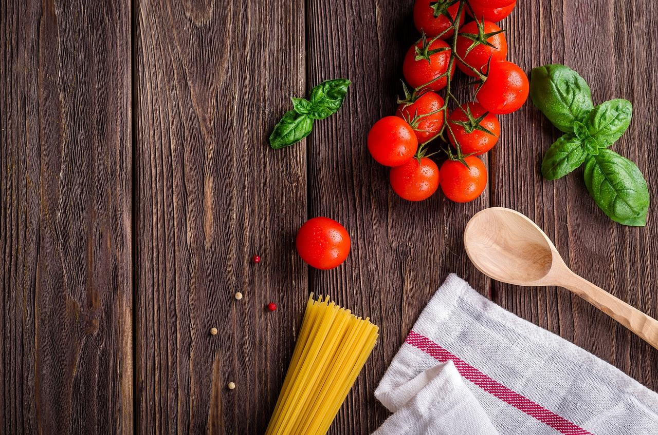

Food At Click
Online food Delivery Web Application
MADE BY
SOURABH MAGDUM 233097
SHUBHAM TIGANE 233093
GUIDE -
Geeta Darunte

Slide 2

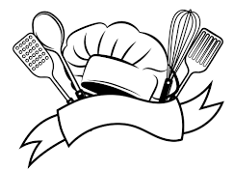
Introduction
Objectives
Scope
Screenshots
Specifications
System Requirements
Conclusions
Future Scope
2

Slide 3
INTRODUCTION
The purpose of this project is to develop a web based online food delivery system that facilitates the seamless ordering of food from restaurants and its subsequent delivery to customers' locations.
This document presents a comprehensive outline of the software requirements for the online food delivery system.
It encompasses design decisions, architectural requirements, and details essential for software maintenance and support.

Slide 4
Objectives
The project scope encompasses the development of a user facing website and a backend administration panel.
The system will enable users to order food from a variety of restaurants and manage these orders efficiently.
Users of the system include customers, restaurant staff, and delivery personnel.

Slide 5


Technology
Backend
Database
FrontEnd
REACT
6

Slide 6
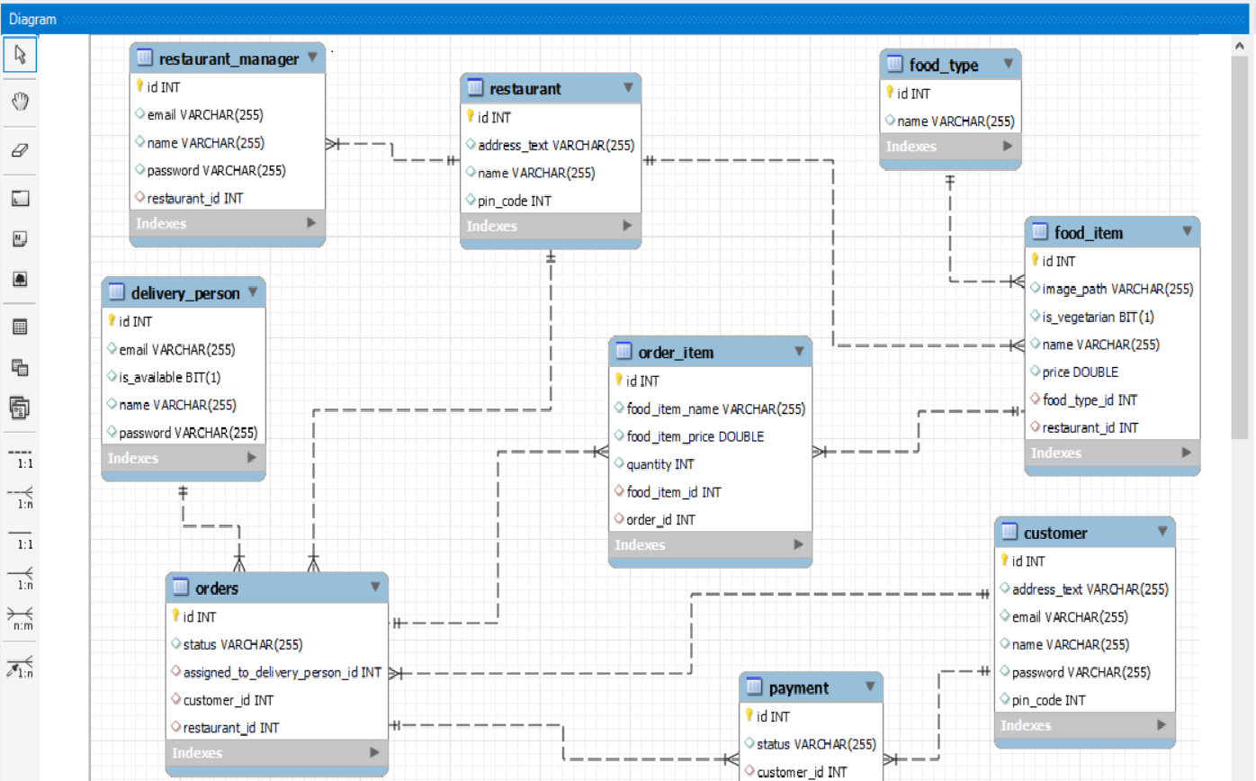
ER Diagram (MySQL generated)

Slide 7
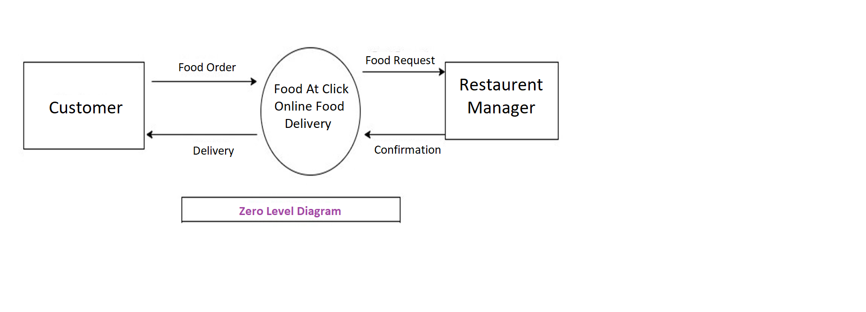
Zero Level diagram

Slide 8
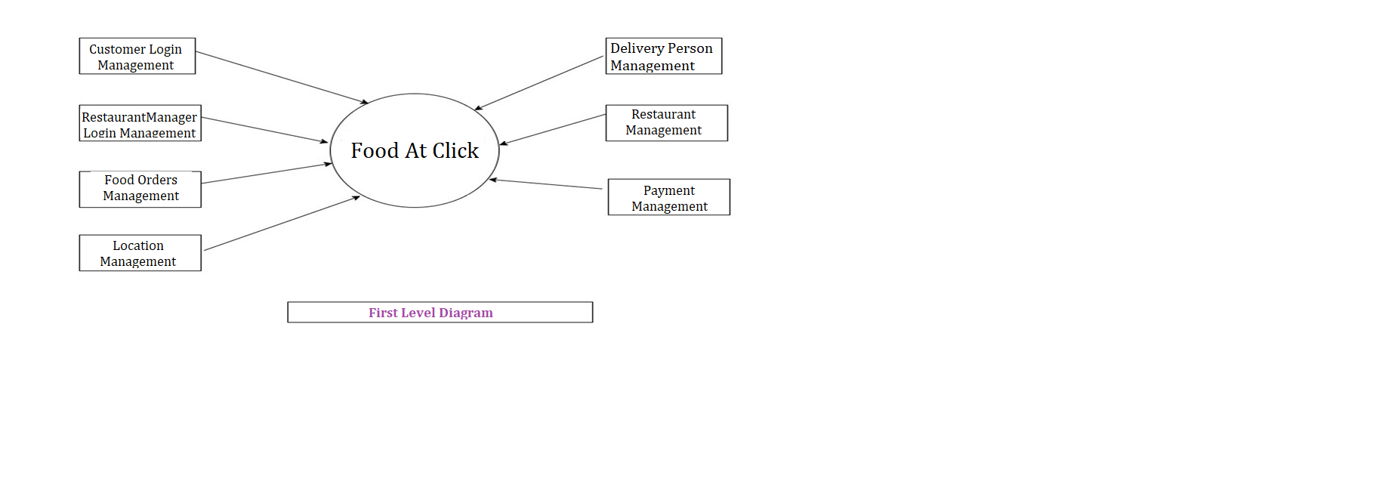
First level diagram

Slide 9
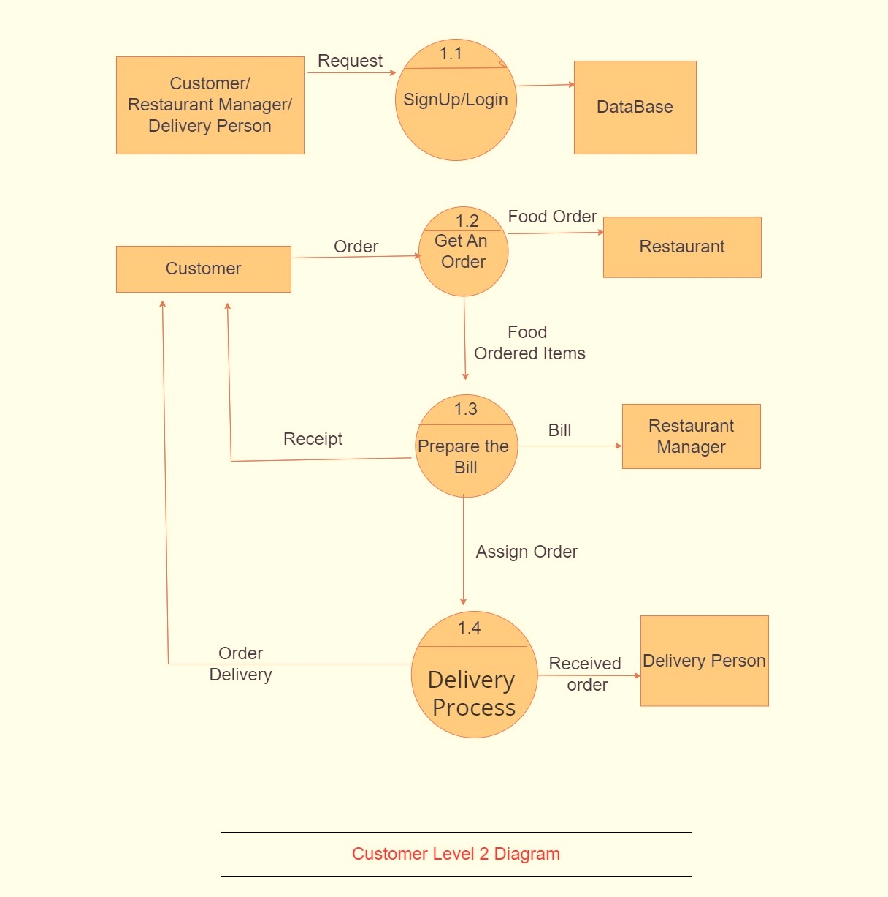
Customer second level diagram

Slide 10
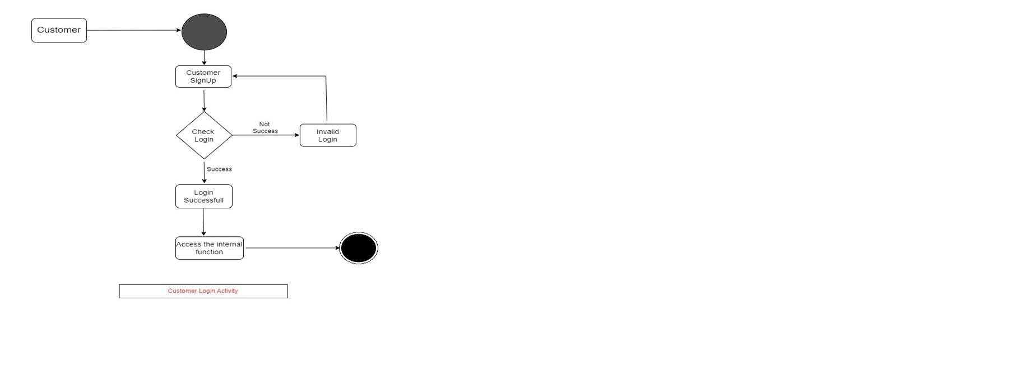
Customer activity diagram

Slide 11
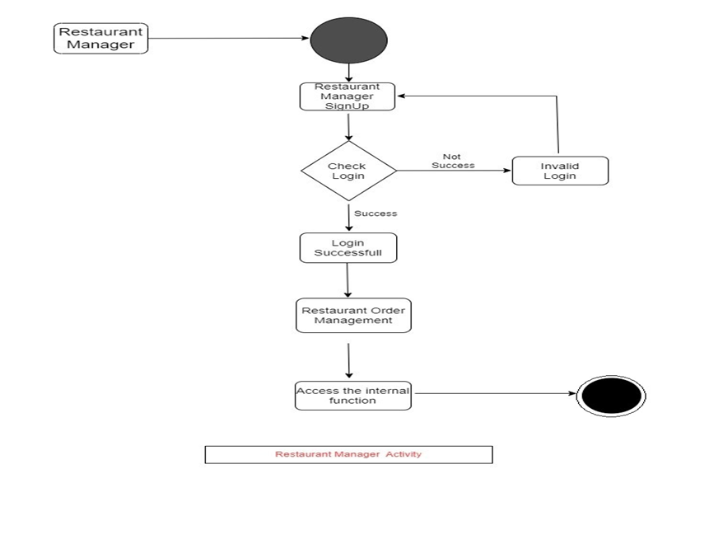
Restaurant manager activity diagram

Slide 12
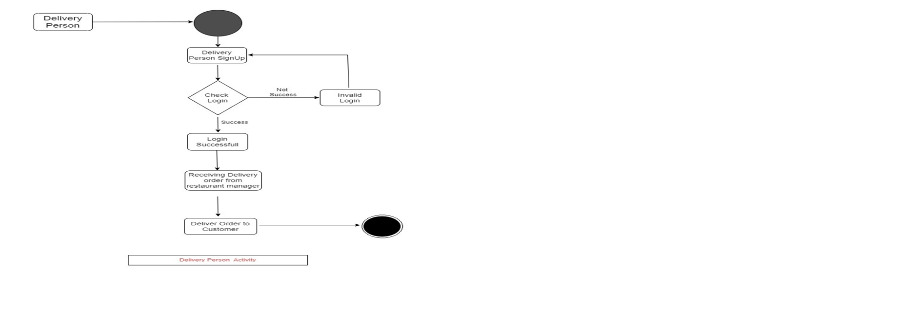
Delivery person activity diagram

Slide 13
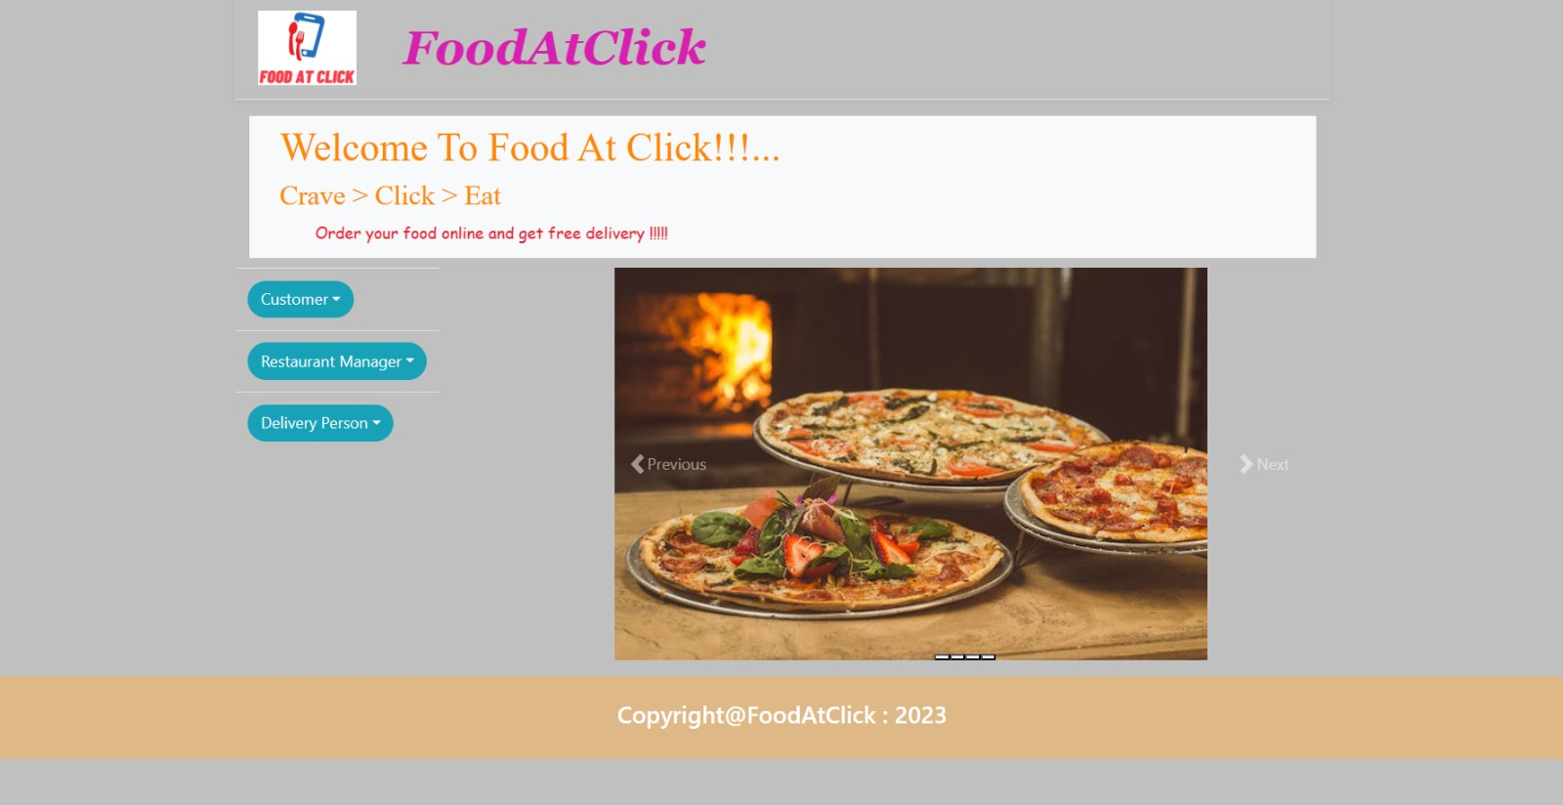
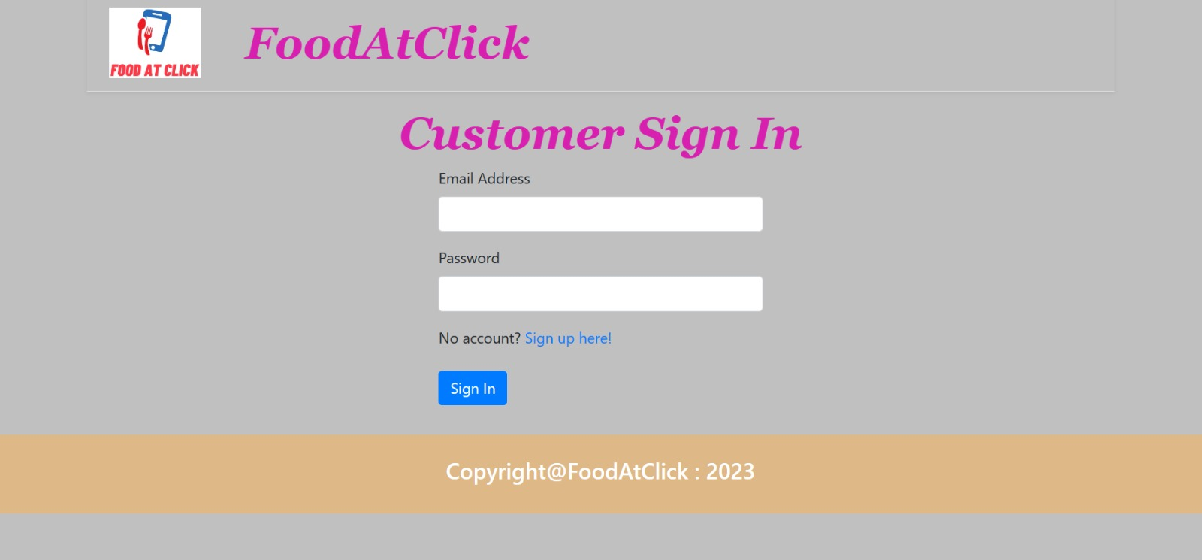
ScreenShot

Slide 14
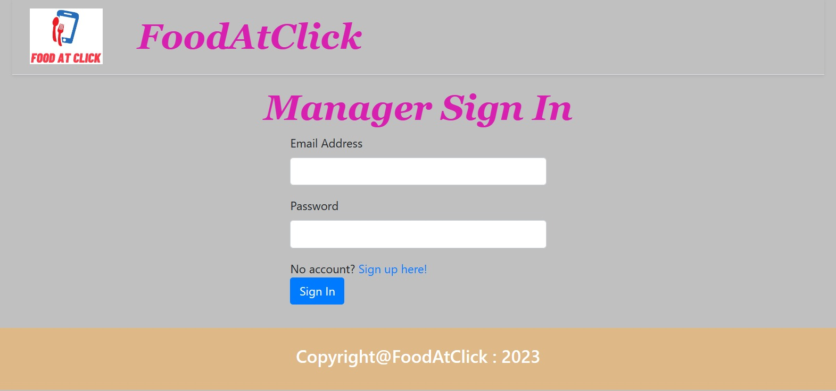
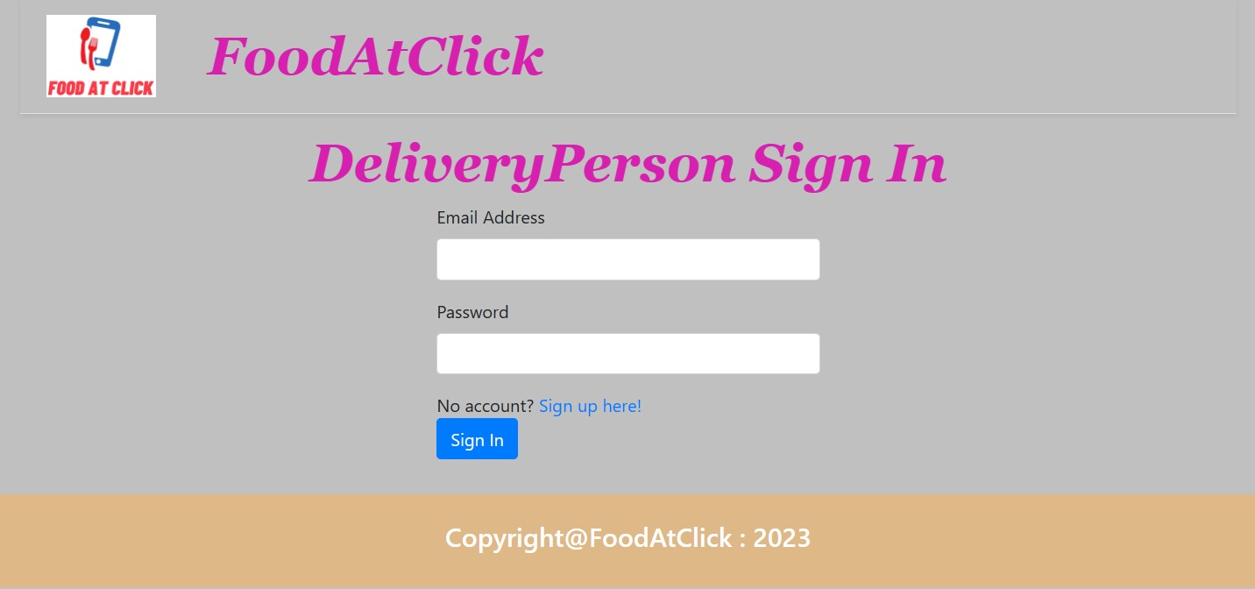
ScreenShot

Slide 15
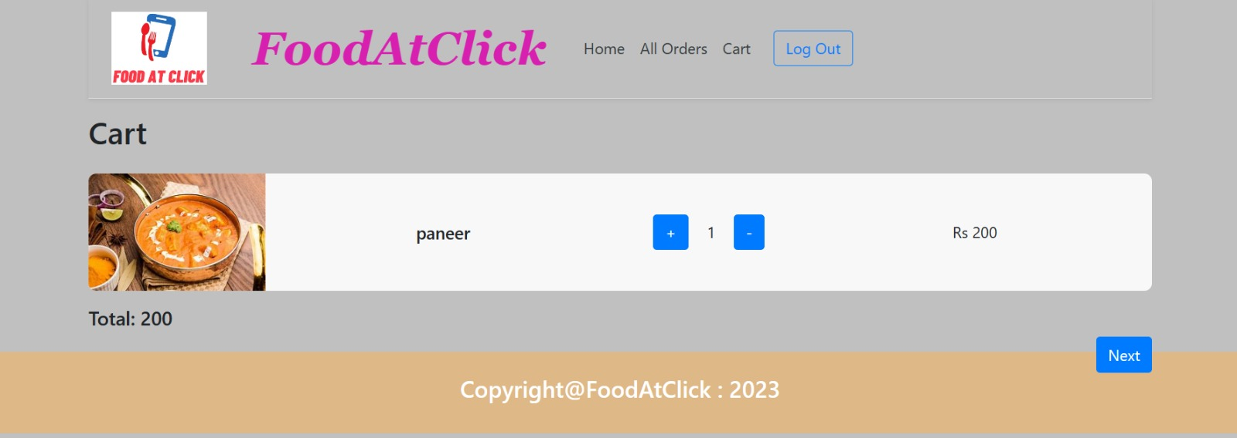
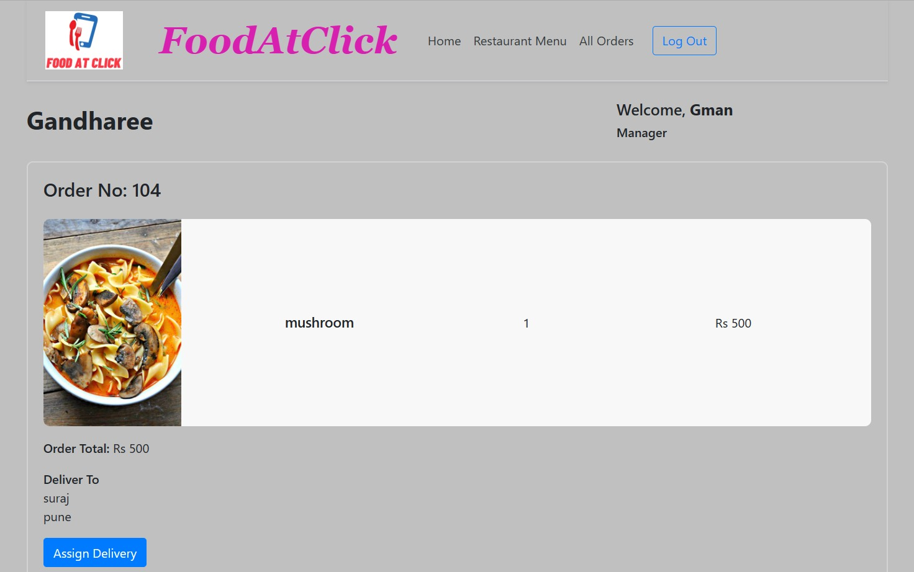
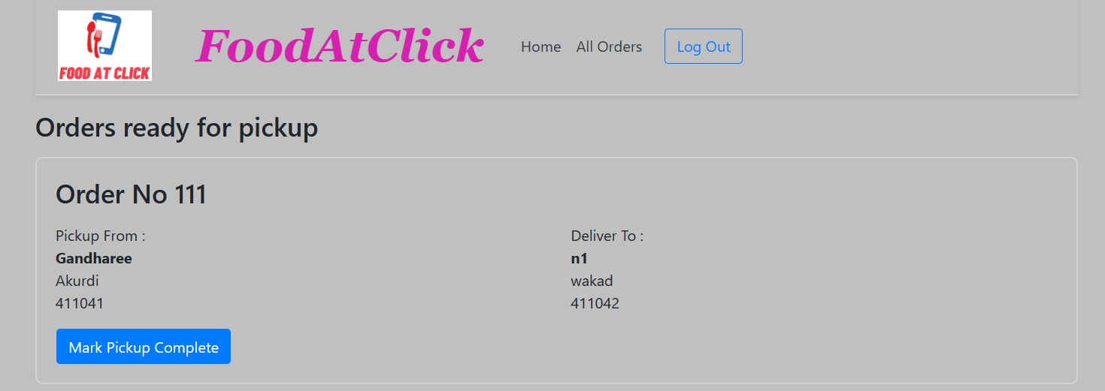
ScreenShot

Slide 16
System requirements
Server side
Processor: Intel i3 8th gen & above
HDD : 500gb & above
RAM :4gb & above
OS: Windows 10 & above
Database :MySQL
JDK 11 & above
Eclipse IDE
Visual Studio Code

Slide 17
System requirements
Client Side
Latest Browser
Chrome / Edge /Mozilla Fire Fox etc
RAM :4gb & above
OS: Android / Windows 10 & above
Stable Internet Connection

Slide 18
Future Scope
This Online Food delivery web application can be enhanced further by adding
live tracking system
review and ratings Feedback system for detailed analysis.
Real time payment system
Note: The software is flexible enough to be modified and implemented as per future needs and requirements.

Slide 19
Conclusion
With the help of this system, people can easily order the food. It can also ensure that the people do not waste their precious time and use their time productively in the other works. In long run, this will ensure that it helps to reduce labour cost. This system proves to be more cost effective and reliable over other systems.
This project can later be expanded on a larger scale. It is developed for restaurants to simplify their routine managerial and operational task and to improve the dining experience of the clients. This also helps the restaurant owners develop healthy customer relationships by providing reasonably good services. The system also enables the restaurant to know the items available in real time and make changes to their food and beverage inventory based on the orders placed and the orders completed.

Slide 20
References
https://medium.com/@ravindersengar/end-to-end-design-of-a-food-delivery-app-like-zomato-or-swiggy-52b96f3a635f
https://medium.com/javarevisited/lets-develop-shopping-cart-for-ecommerce-app-8e57a9ab4868
https://github.com/coniferousdyer/Food-Ordering-Portal.git

Slide 21
Thank you

